Slide 1
Group 6
Platformer Game
Matthew Morado, Steven Duran, Chris Nikolich, Juan Ramirez

Slide 2
Introduction
Platformer Game is a game made in javascript with the framework Phaser. You must go through levels where you fight enemies and beat the boss of each level.
Phaser is a framework with built in features to aid in building a game
State handing
Sprite Handling
Collision Detection
Etc.
Go and Goapp to run a web server
Sublime as an editor
Mocha and Chai for testing
TexturePacker for creating spritesheets

Slide 3
Requirements
Have a player that can run and shoot
Player can die and get a game over
Player has an experience bar that can make it stronger
Have a level with obstacles for the player to challenge
Platforming
Player dies if they fall in a pit
Have an enemies for the player to fight against
Have a main menu where the user can transition between levels

Slide 4
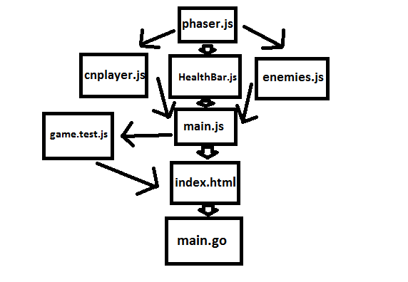

Slide 5

Level Editing
Used the TILED map editor
A futuristic theme where metal is prevalent
Player and enemy as follow this theme
Separated in multiple layers
Created walkways for a player and enemies and platforming obstacles
Created an arena for the boss at the end of the level

Slide 6
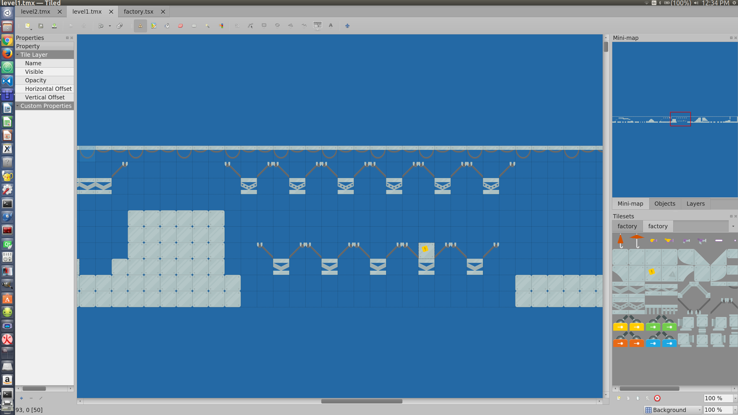

Slide 7
Level Editing Difficulties
No easy way to efficiently test level other than manually playing
Problem with player occasionally falling through tiles
Limited art skills mean I have to rely on finding already existing and free to use tileset

Slide 8

Player Features
Bullet collision with enemies
Kill enemies
Player-Enemy collision
Player recieve damage
Player HUD
Player Health bar
Player experience bar
Player animations
Shoot
Run
Shoot while running
jumping

Slide 9
Player Feature Difficulties
Mostly technical issues
JS
Phaser framework
TexturePacker
Implementing player animations

Slide 10
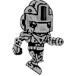
Enemy Features
Enemies have a health bar hovering above them
Depletes as they take damage
Melee Enemies that hurt the player on contact
Can chase the player around the level
Shooting Enemies that hurt the player with projectiles
Can determine where the player will be and fire accordingly
A boss at the end of a level with unique characteristics

Slide 11
Enemy Feature Difficulties
Collisions
Enemy pathfinding
Finding models/animations
Placing enemies in the world
Unit testing for enemy ai

Slide 12
Unit testing
Using mocha and chai
Tests to see if the level is complete enough to play
Tests check enemy actions
Check player attributes and enemies
The tests run at the end of the creation phase of the level so it doesn’t interfere with performance

Slide 13
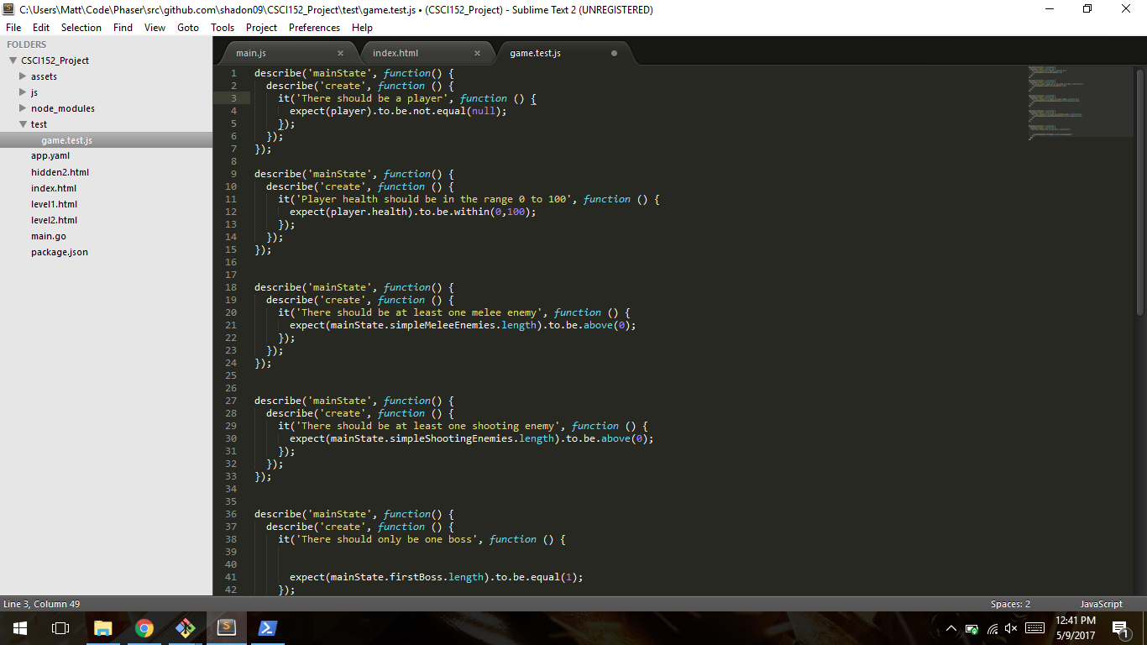

Slide 14
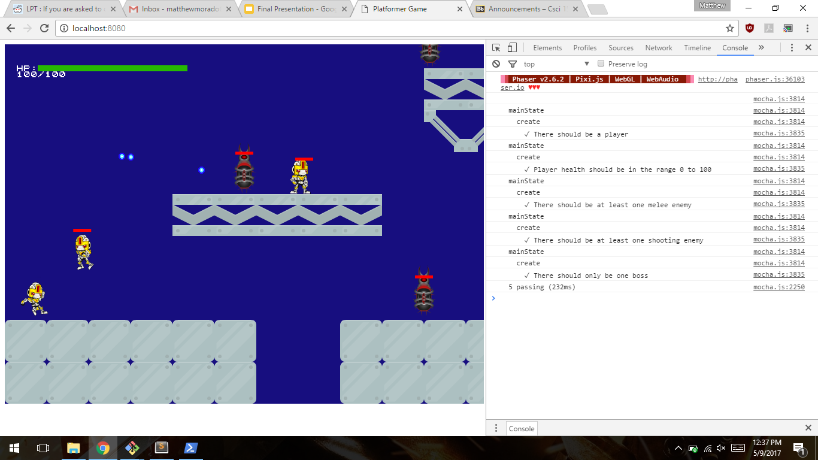

Slide 15
Unit Testing Problems
Mocha and chai don’t go too well with state based programs
Can’t run mocha by itself without the game running
Testing during a level insufficient

Slide 16
Possible Improvements
More levels
More variety of sprites
Sound
Better GUI

